Slide 1

Gradesheet Management System
A presentation by:
Siddhartha Shakya
BIM (1st Semester)
Section: B

Slide 2
Introduction
The Gradesheet Management System is a software application developed to simplify the process of managing student grades and information.

Slide 3
Objectives
Simplify gradesheet management processes.
Ensure precise grade calculations.
Provide easy access to grade data.
Maintain orderly grade records.
Gain insightful performance reports.

Slide 4
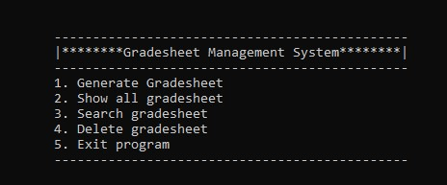
Features
1. Generate Gradesheet: Create a new gradesheet for a student.
2. Show all Gradesheets: Display all existing gradesheets.
3. Search Gradesheet: Find a gradesheet by student registration number.
4. Delete Gradesheet: Remove a gradesheet from the system.

Slide 5

Data Input
Students provide their personal information such as name, registration number, faculty, and semester. They also enter marks for each subject.

Slide 6
Grade Calculation
The application calculates the total marks and percentage for each student. It also assigns grades (A+, A, B+, B, C, NG) based on predefined criteria.

Slide 7

Data Storage
Student data, including personal details and grades, are stored in a file named 'student.txt' within the application directory.
This Photo by Unknown author is licensed under CC BY.

Slide 8

This Photo by Unknown author is licensed under CC BY-SA-NC.

